Slide 1
SCREENSHOTS OF OUTPUTS

Slide 2
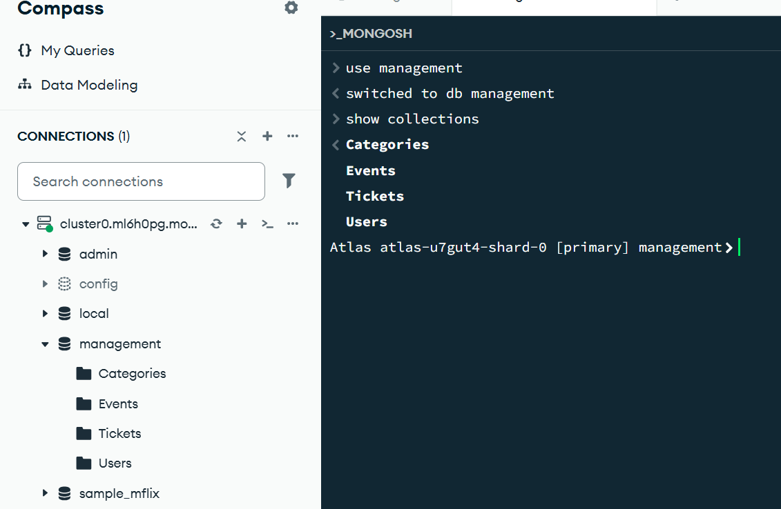
To see all available databases, in your terminal type show dbs.
To see or create or use database write :
use <database name>
To make collection write
db.createCollection(“<collectionname>")
To see collections
show collections

Slide 3
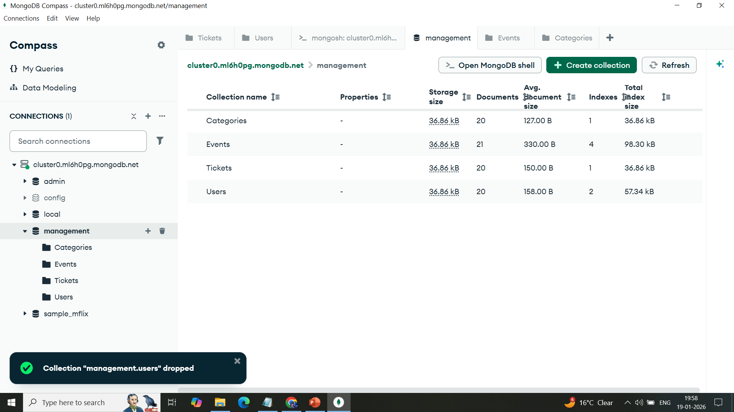
4 collections under management have been made
1.Users
2.Tickets
3.Events
4.Ctegories

Slide 4
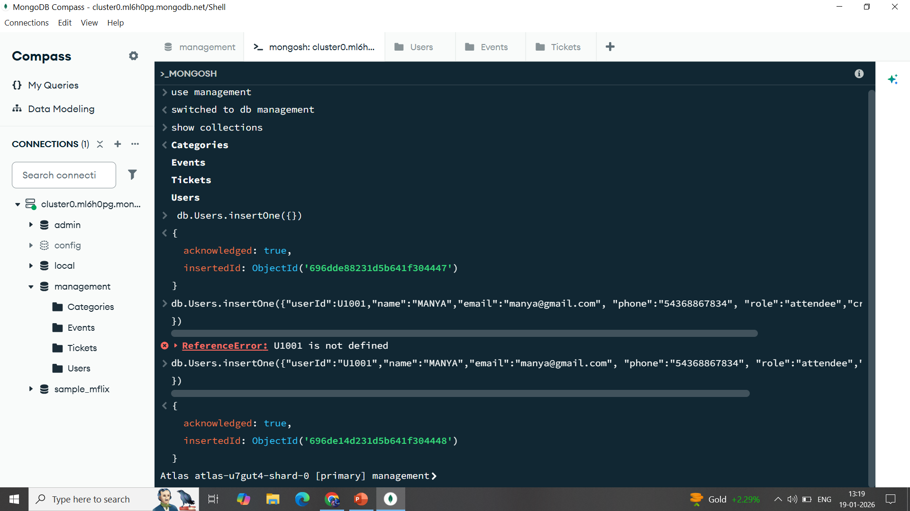

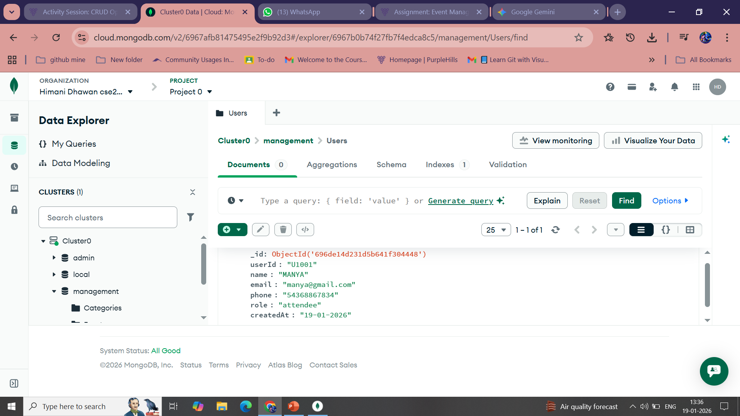
Use of insertone/insertmany in order to add contents make fields in any collection

Slide 5
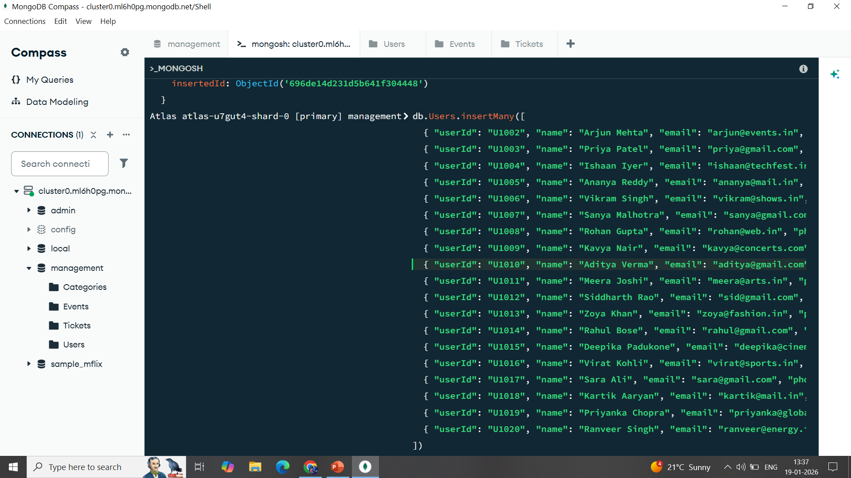
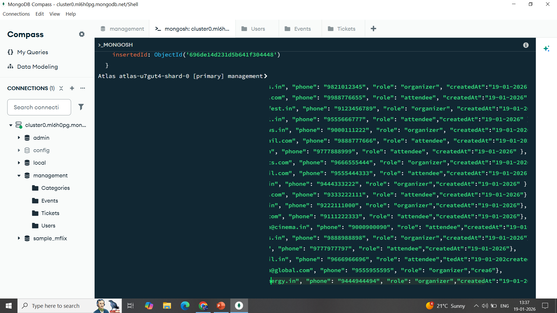

Slide 6
For user collection data is inputted as
db.Users.insertMany([
{ "userId": "U1002", "name": "Arjun Mehta", "email": "arjun@events.in", "phone": "9821012345", "role": "organizer", "createdAt":"19-01-2026" },
{ "userId": "U1003", "name": "Priya Patel", "email": "priya@gmail.com", "phone": "9988776655", "role": "attendee", "createdAt":"19-01-2026" },
{ "userId": "U1004", "name": "Ishaan Iyer", "email": "ishaan@techfest.in", "phone": "9123456789", "role": "organizer", "createdAt":"19-01-2026" },
{ "userId": "U1005", "name": "Ananya Reddy", "email": "ananya@mail.in", "phone": "9555666777", "role": "attendee","createdAt":"19-01-2026" },
{ "userId": "U1006", "name": "Vikram Singh", "email": "vikram@shows.in", "phone": "9000111222", "role": "organizer", "createdAt":"19-01-2026" },
{ "userId": "U1007", "name": "Sanya Malhotra", "email": "sanya@gmail.com", "phone": "9888777666", "role": "attendee", "createdAt":"19-01-2026" },
{ "userId": "U1008", "name": "Rohan Gupta", "email": "rohan@web.in", "phone": "9777888999", "role": "attendee", "createdAt":"19-01-2026" },
{ "userId": "U1009", "name": "Kavya Nair", "email": "kavya@concerts.com", "phone": "9666555444", "role": "organizer","createdAt":"19-01-2026" },
{ "userId": "U1010", "name": "Aditya Verma", "email": "aditya@gmail.com", "phone": "9555444333", "role": "attendee","createdAt":"19-01-2026"},
{ "userId": "U1011", "name": "Meera Joshi", "email": "meera@arts.in", "phone": "9444333222", "role": "organizer","createdAt":"19-01-2026" },
{ "userId": "U1012", "name": "Siddharth Rao", "email": "sid@gmail.com", "phone": "9333222111", "role": "attendee","createdAt":"19-01-2026"},
{ "userId": "U1013", "name": "Zoya Khan", "email": "zoya@fashion.in", "phone": "9222111000", "role": "organizer","createdAt":"19-01-2026"},
{ "userId": "U1014", "name": "Rahul Bose", "email": "rahul@gmail.com", "phone": "9111222333", "role": "attendee","createdAt":"19-01-2026"},
{ "userId": "U1015", "name": "Deepika Padukone", "email": "deepika@cinema.in", "phone": "9000900090", "role": "attendee","createdAt":"19-01-2026" },
{ "userId": "U1016", "name": "Virat Kohli", "email": "virat@sports.in", "phone": "9888988898", "role": "organizer","createdAt":"19-01-2026"},
{ "userId": "U1017", "name": "Sara Ali", "email": "sara@gmail.com", "phone": "9777977797", "role": "attendee","createdAt":"19-01-2026"},
{ "userId": "U1018", "name": "Kartik Aaryan", "email": "kartik@mail.in", "phone": "9666966696", "role": "attendee","tedAt":"19-01-202","createdAt":"19-01-2026"},
{ "userId": "U1019", "name": "Priyanka Chopra", "email": "priyanka@global.com", "phone": "9555955595", "role": "organizer","createdAt":"19-01-2026"},
{ "userId": "U1020", "name": "Ranveer Singh", "email": "ranveer@energy.in", "phone": "9444944494", "role": "organizer","createdAt":"19-01-2026"}
])

Slide 7
Through same method we will make atleast 20 entries in each collection

Slide 8
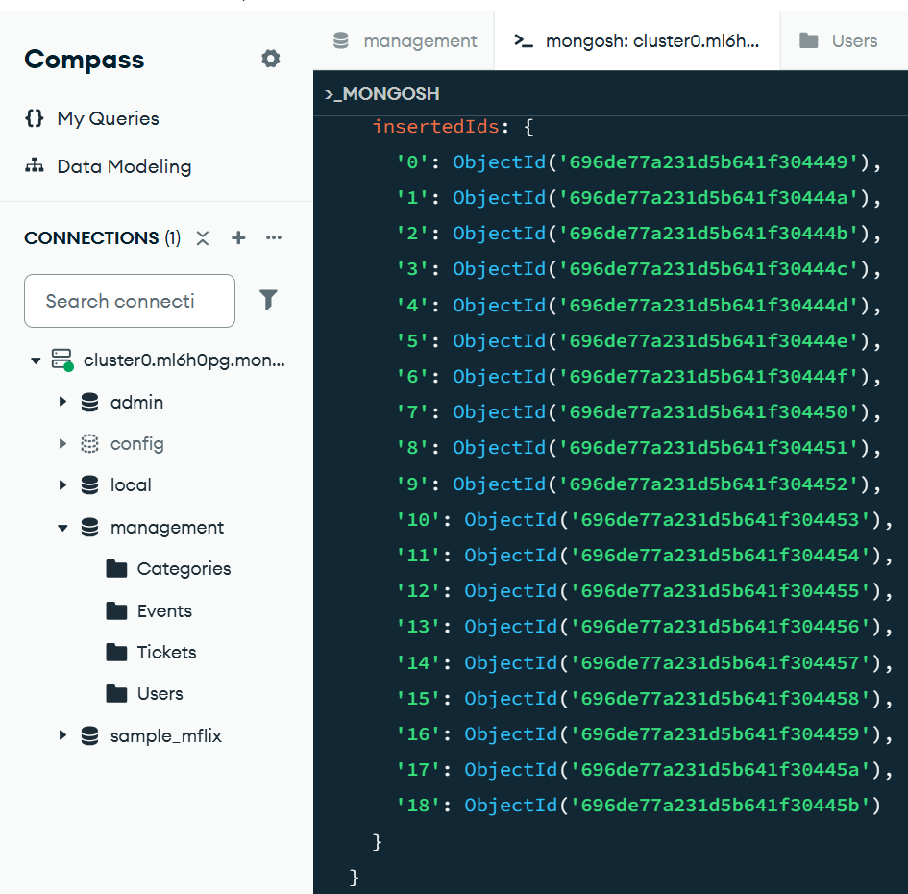

Slide 9
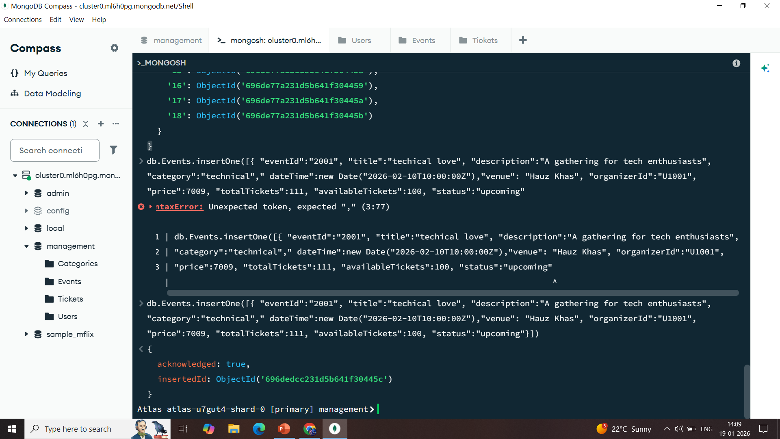
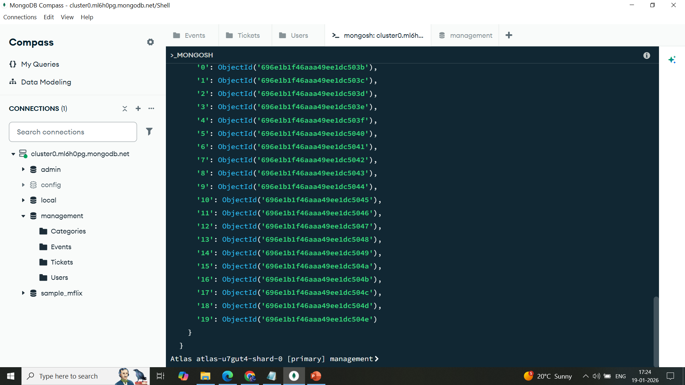
For tickets

Slide 10
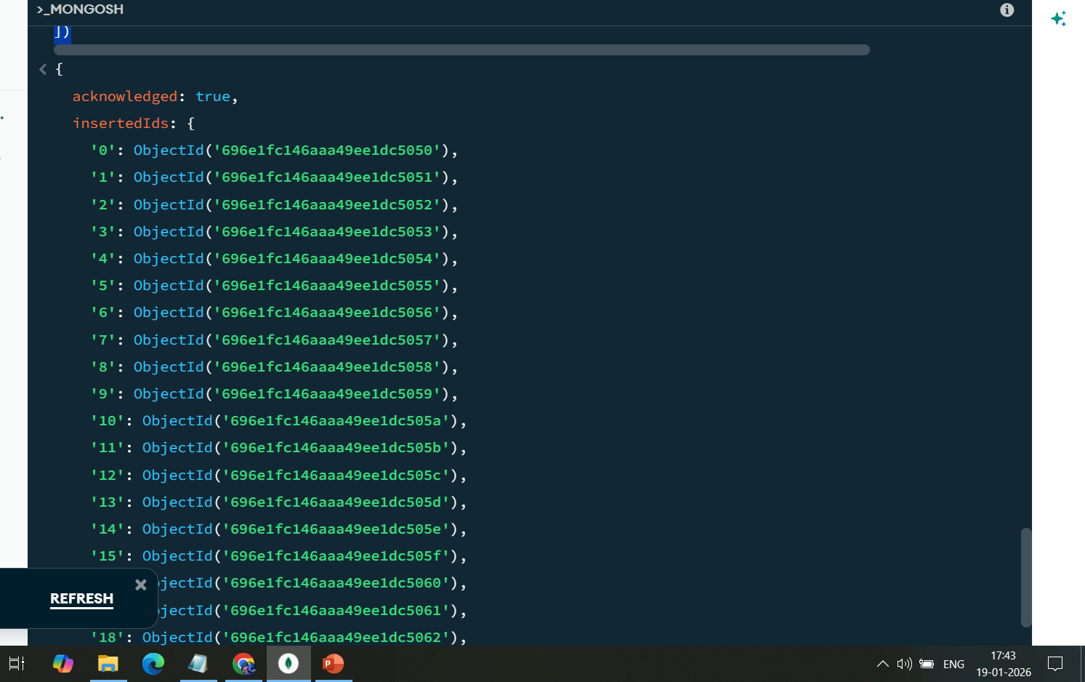
For categories

Slide 11
CRUD OPERATIONS IN ALL 4 COLLECTIONS
Create: insertOne(), insertMany()
Read: find(), findOne()
Update: updateOne() or updateMany() methods.
Delete: We can delete documents by using the methods deleteOne() or deleteMany().

Slide 12
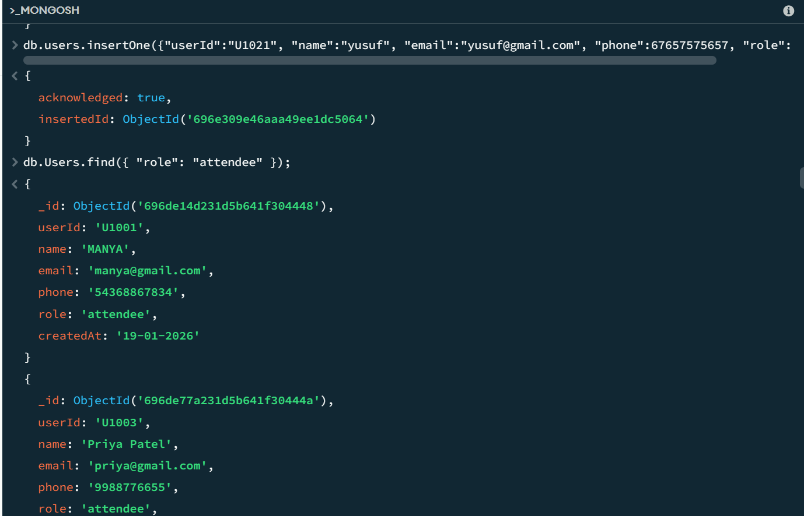
CRUD OPERATIONS

Slide 13
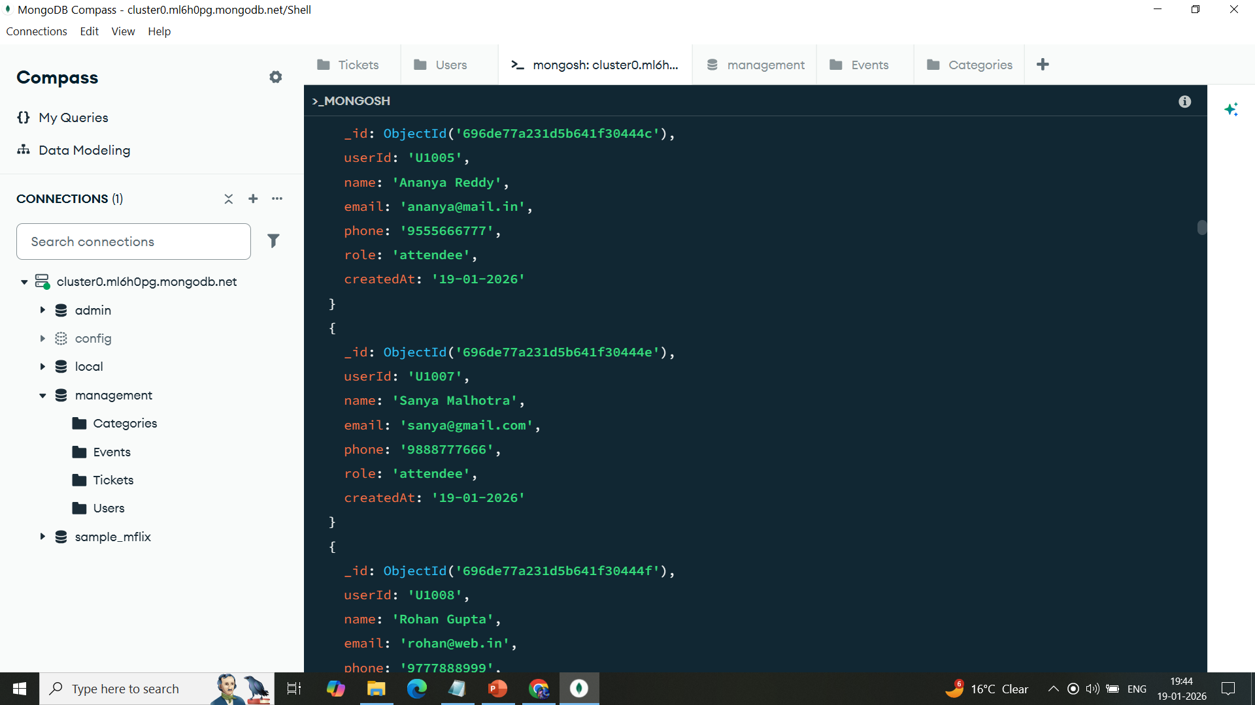
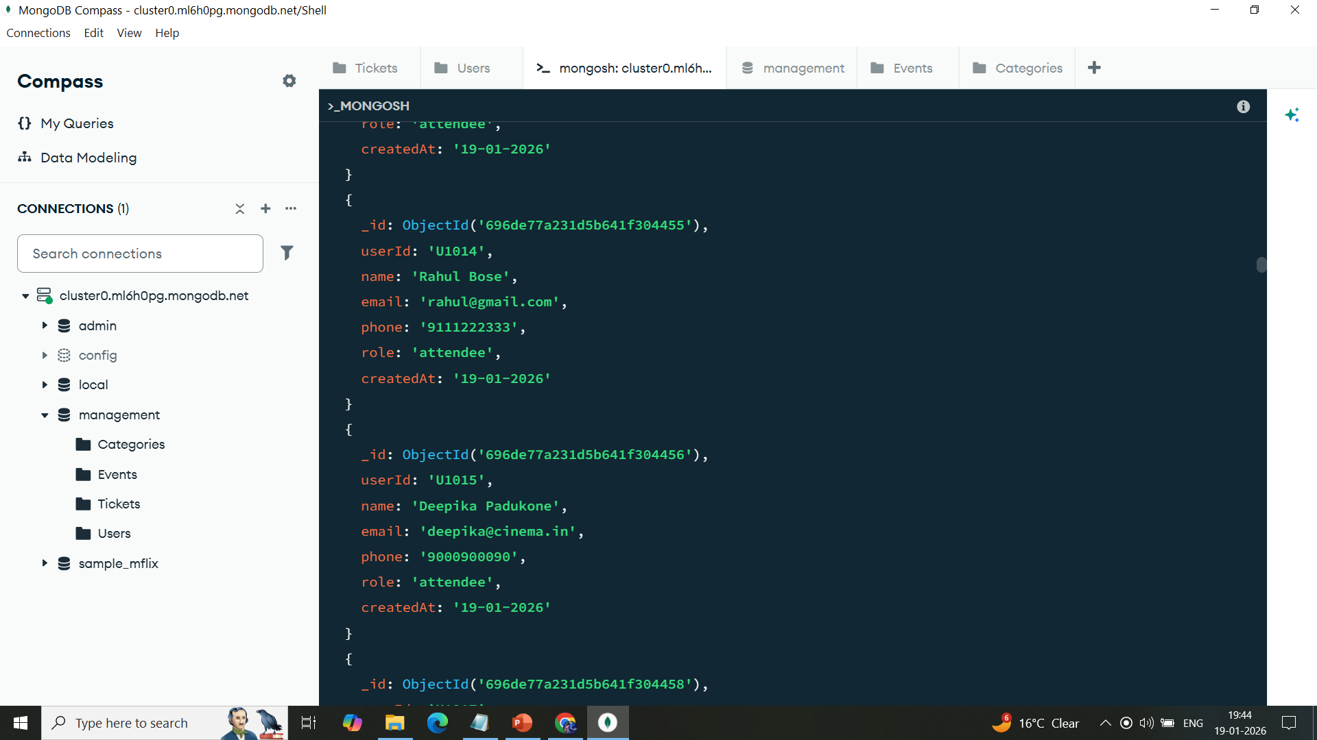

Slide 14
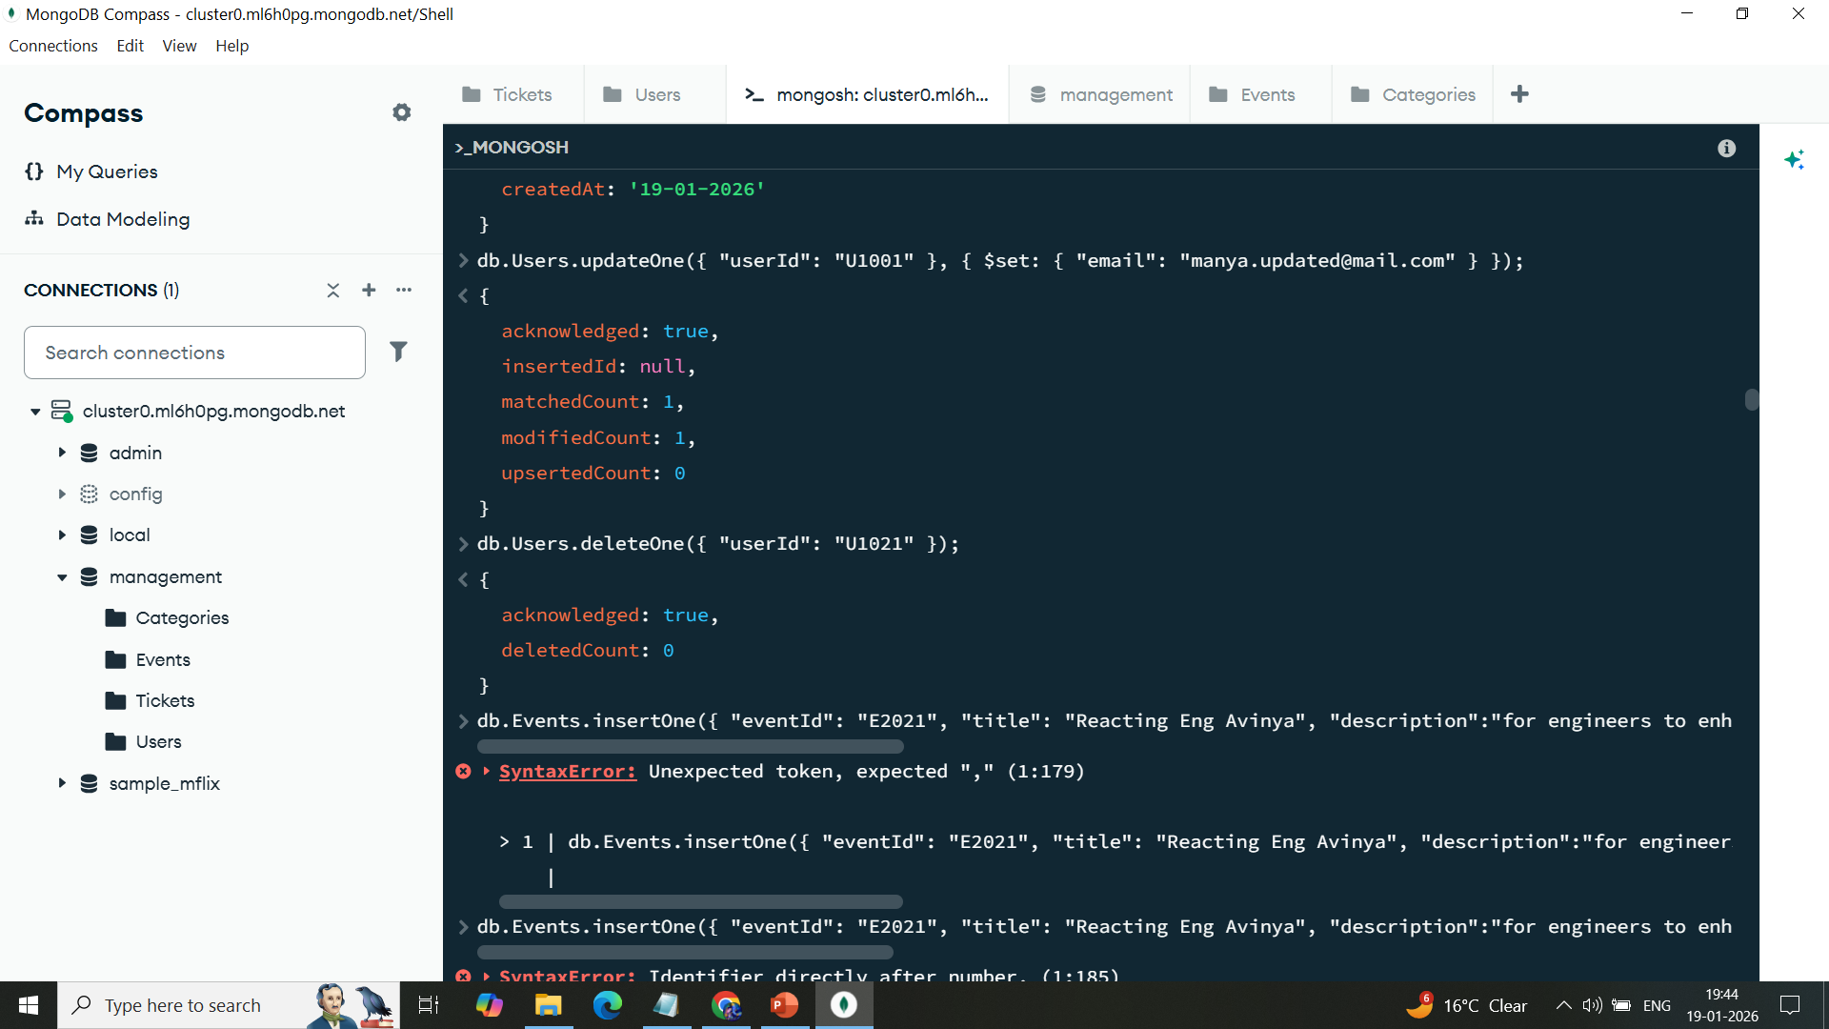

Slide 15
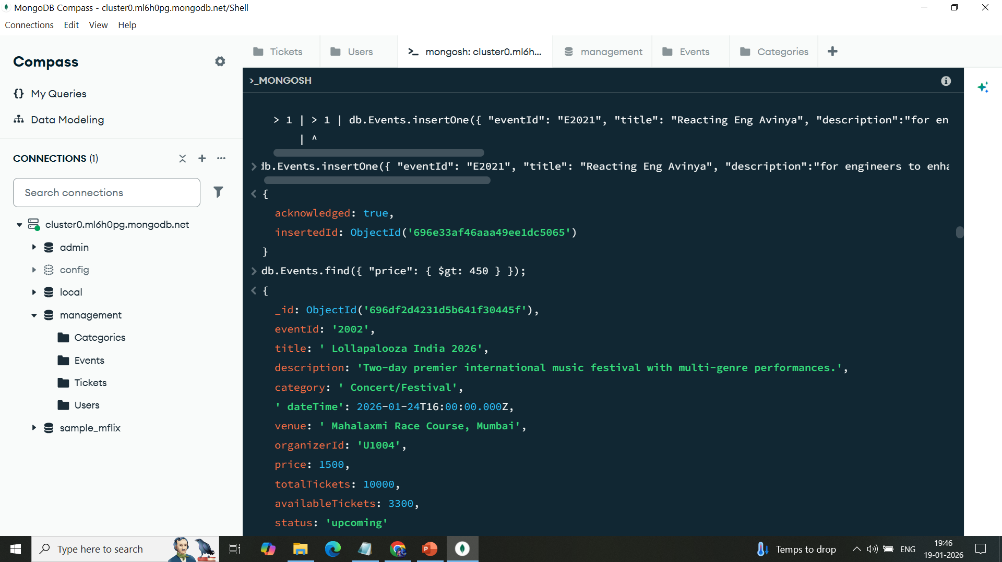


Slide 16
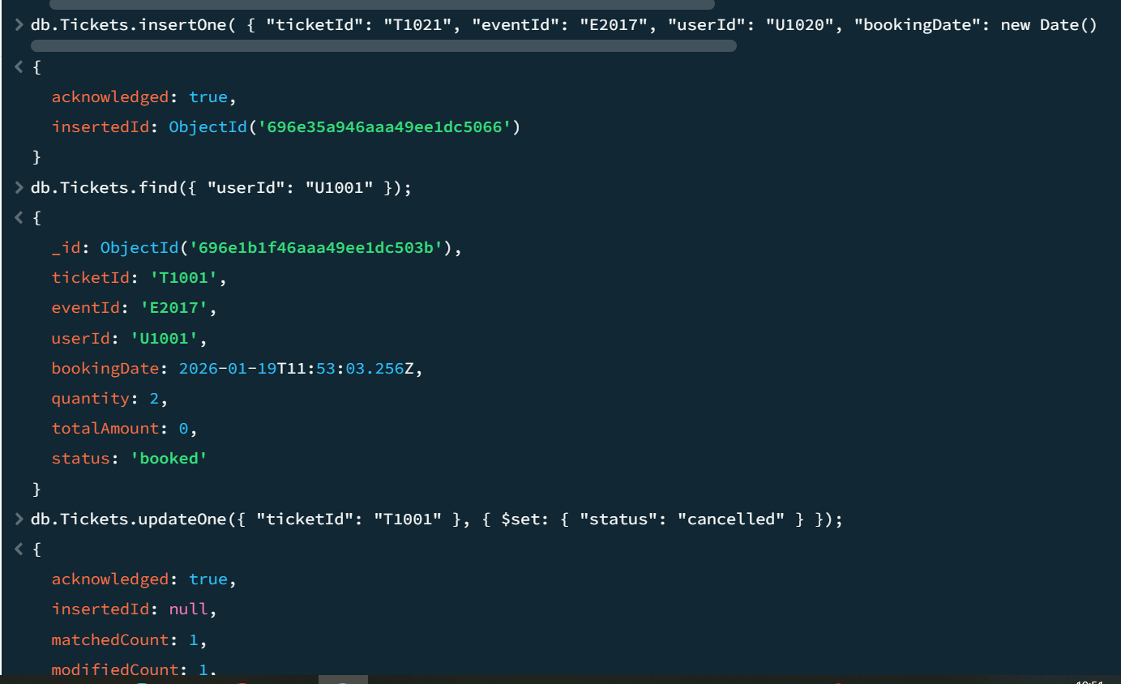

Slide 17
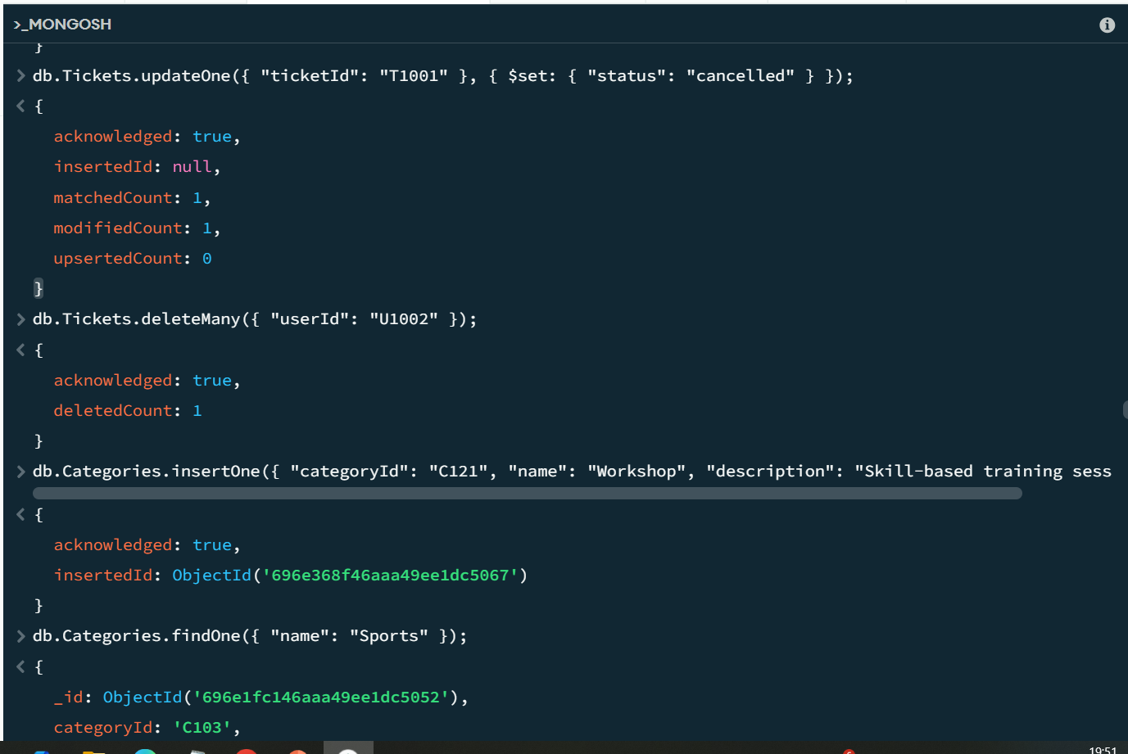

Slide 18
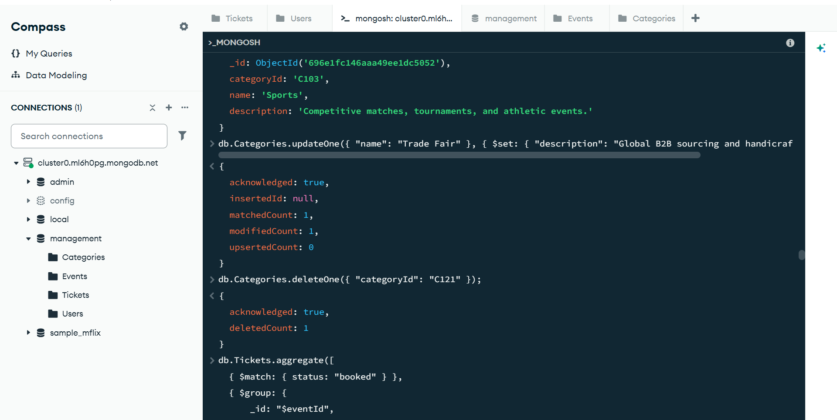

Slide 19
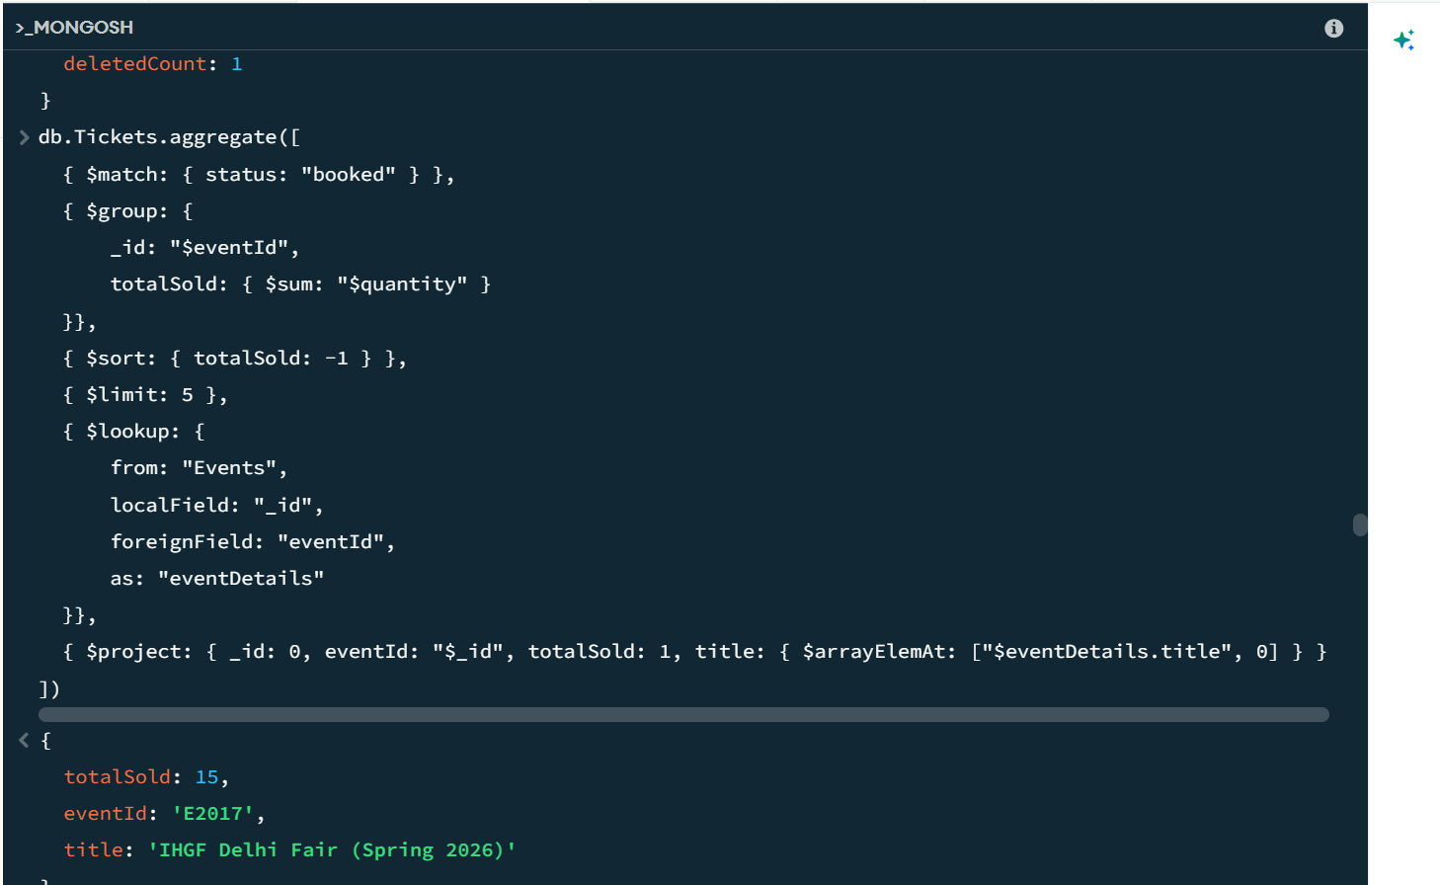
AGGREGATION

Slide 20


Slide 21
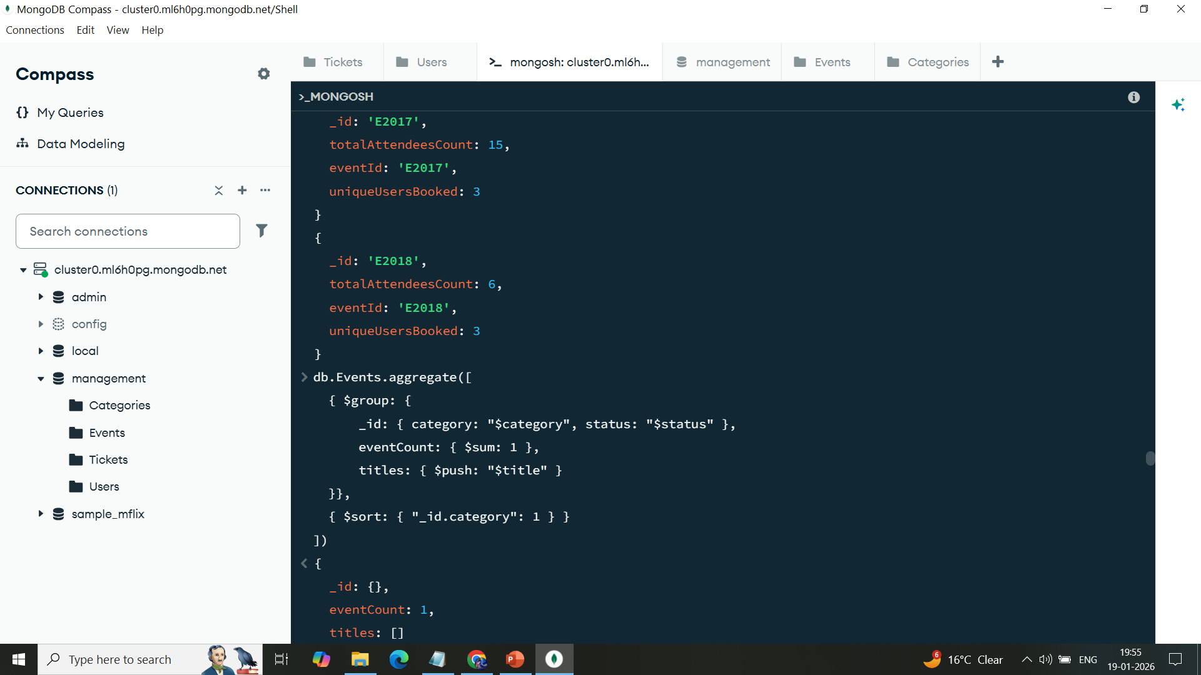

Slide 22
